Slide 1
Lecture 1
Introduction and overview of Cancer Biology
Oct 8, 2023
Xue-Song Liu
liuxs@shanghaitech.edu.cn
Notes:
什么是cancer? 这门科学研究目前状况？目前研究热点… 肿瘤基因组，肿瘤精准医疗，免疫疗法

Slide 2
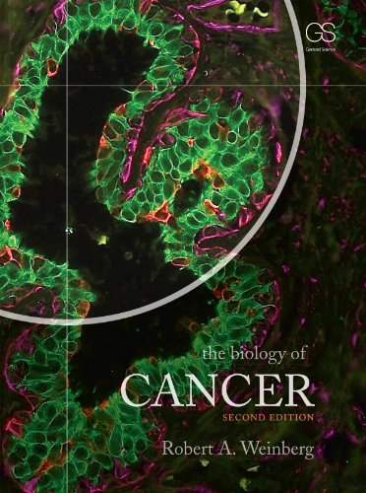
参考书:
The Biology of Cancer, 2nd edition, 2014, Robert Weinberg
癌生物学，2009，科学出版社 (The Biology of Cancer, 1st edition, 翻译版)
《癌症生物学》 刘雪松 编著 2024待出版…
建议重点读图(Figure)、图注释 (Figure Legend)、章节标题 (Caption)以及每章最后的总结与展望 (Synopsis and prospects)
Notes:
考核方式：平时 30% 期中 30% 期末 40%

Slide 3
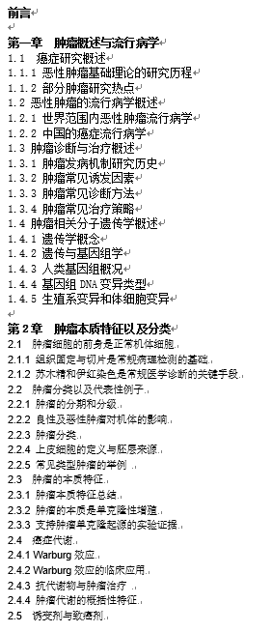
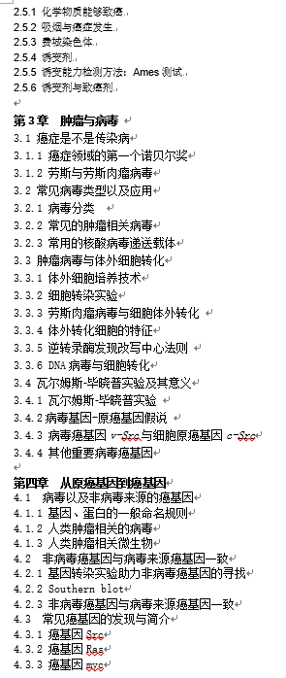
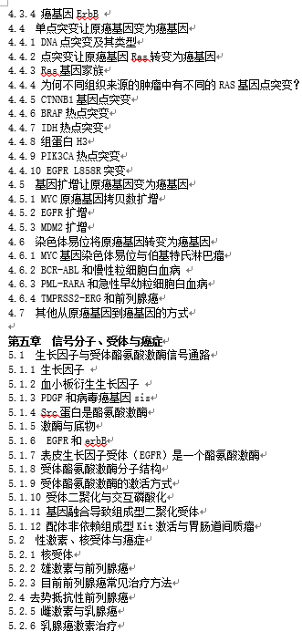
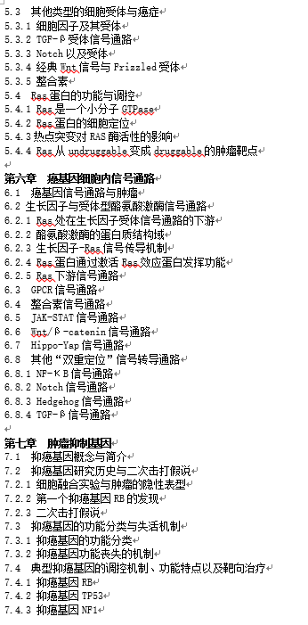
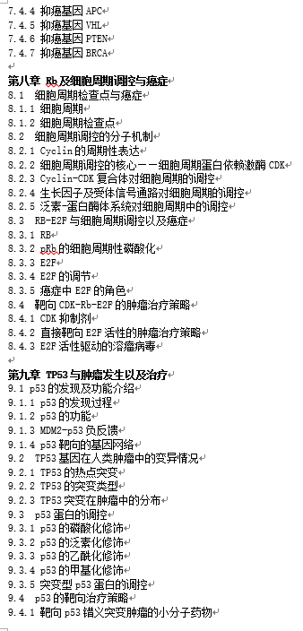
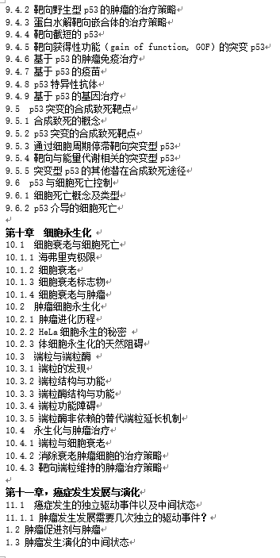
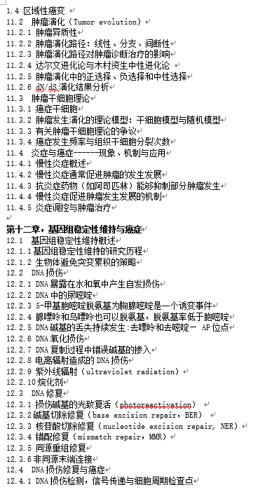
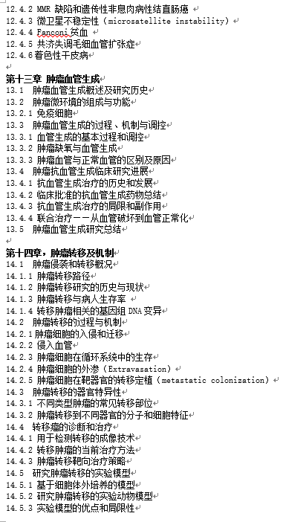
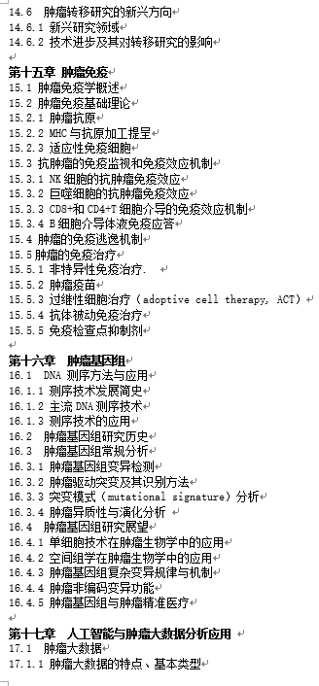
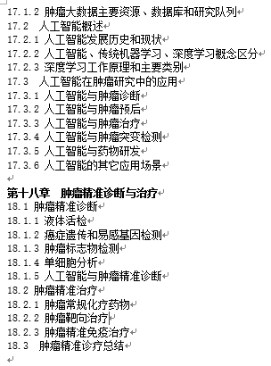
《癌症生物学》
目录

Slide 4
Overview of 2022 Cancer Biology courses
Lecture 1: Introduction and overview of Cancer Biology (Oct 8)
Lecture 2: The nature of cancer (Oct 13)
Lecture 3: Tumor viruses (Oct 18)
Lecture 4: Cellular oncogenes (Oct 20)
Lecture 5: Growth factor, receptor and cancer (Oct 27)
Lecture 6: Cytoplasmic signaling and cancer (Nov 1)
讨论课1（1-6节内容）(Nov 3)
Lecture 7: Tumor suppressor genes (Nov 10)
Lecture 8: pRB, cell cycle control (Nov 15)
Lecture 9: P53 and cancer (Nov 17)
期中考试（30%，1-9节内容）(Nov 24)
Lecture 10: Cell immortalization and tumorigenesis (Nov 29)
Lecture 11: Multi-step tumorigenesis (Dec 1)
Lecture 12: Genome integrity maintenance and cancer (Dec 8)
讨论课2 （7-12节内容）(Dec 13)
Lecture 13: Tumor angiogenesis (Dec 15)
Lecture 14: Tumor metastasis (Dec 22)
Lecture 15: Tumor immunology and immunotherapy (Dec 27)
Lecture 16: The rational treatment of cancer (Dec 29)
Lecture 17: Cancer genome (Jan 5)
Lecture 18: Cancer precision therapy status and challenges (Jan 10)
讨论课3 （13-18节内容）(Jan 12)
期木考试（40%）
Cancer classification
History of cancer research
Oncogene and cancer signaling
Tumor suppressors
Key steps in cancer progression
Cancer immunotherapy
Cancer precision therapy
Notes:
目前的共识在多年以前是不可思议的; 肿瘤发生关键是肿瘤自身变异，也就是说肿瘤细胞和正常细胞是不一样的，后面我们会提到最根本的不一样是genetic 变异。 除此之外，肿瘤与周围环境细胞相互作用也很重要。重点, 不仅注重知识，也注重知识的发展历史以及每个时期的局限性。

Slide 5
What is expected to learn after this course?
New knowledge, 学习新的知识（包括发现知识的历史），新的生物技术；
肿瘤生物学是一个不断演化的学科，很多问题没有明确答案！
New questions, 重要的是发现肿瘤研究中尚未解决的问题, 尤其是目前有条件解决的问题
New directions, 在此基础上，找到未来的工作、研究方向（研究机会/商业机会）
Notes:
现在的知识在多年以前是不可思议的，当然在多年以后可能也是荒谬的。知识在不停更新，问题依然还在，因而更重要！

Slide 6
Bio-techniques described in this course
Molecular level: Western Blot, Southern blot, Northern blot, Real time PCR, transfection, immune-precipitation,
Chromatin IP, immunofluorescence, Scanning electron microscope, Mass-spectrometry, etc.
Cell/Pathological level: Cell culture, Tissue fixation, HE staining, Immunohistochemistry, in vivo imaging, computerized tomography (CT), Magnetic resonance imaging (MRI), positron emission tomography (PET), flow cytometry, in situ hybridization, etc.
System/Omic level: Microarray, RNA-seq, ChIP-seq, CGH array, SNP array, 2nd generation sequencing, Bioinformatics, Cancer genomics analysis, etc.
Notes:
生物学的进步离不开技术，肿瘤研究同样离不开生物技术

Slide 7
Outline of Today`s lecture
1，Overview of cancer epidemiology (流行病学);
2，Common cancer causes, detection and treatment options
(常见肿瘤致病因素，检测与治疗手段)
3，Brief introduction to cancer related Genetics and Molecular Biology
(简要介绍肿瘤相关遗传、分子生物学)

Slide 8
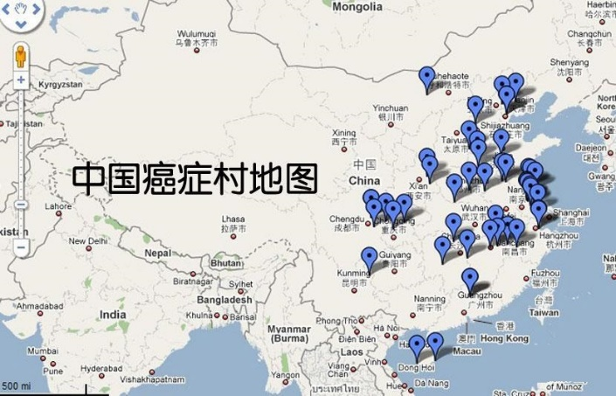
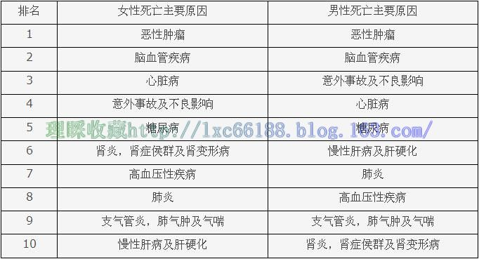
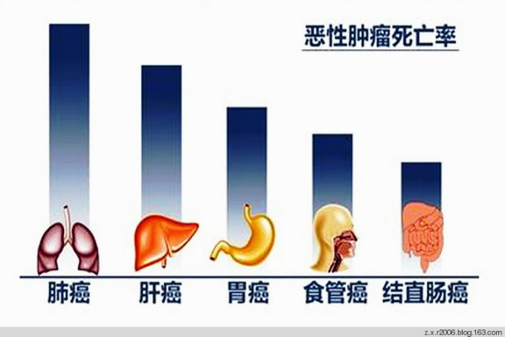
Cancer in China
Notes:
从网上下载的图片，肿瘤与衰老相关，几乎所有人都无法避免

Slide 9
Cancer in China
Nearly 1,800,000 – 2,000,000 people in China diagnosed with cancer each year
About 1,400,000 – 1,500,000 people will die from cancer, almost three per minute
One in four deaths (age 0 -64) in China is caused by cancer
Cancer death increased by 29% (12% after age adjustment) from 1990 – 2000

Slide 10
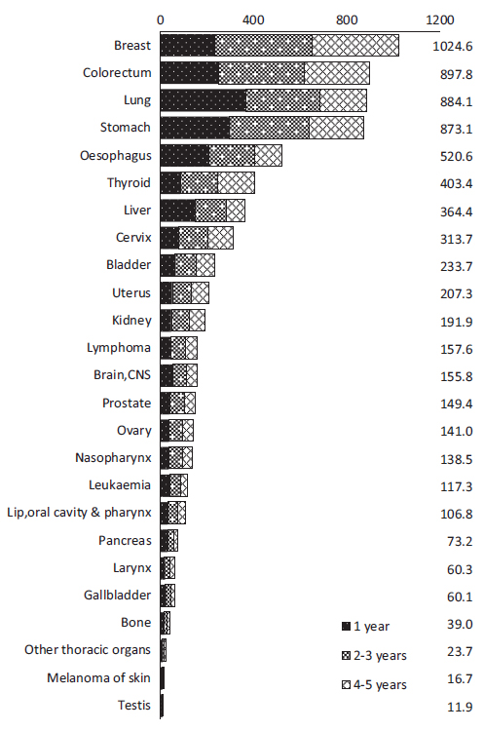
中国肿瘤类型分布
5-year cancer-specific prevalence counts (thousands) by year in China, 2011.
Cancer prevalence is defined as the number of persons diagnosed with cancer within a fixed time in the past.
National estimates of cancer prevalence in China, 2011.
Zheng R, Zeng H, Zhang S, Chen T, Chen W.

Slide 11
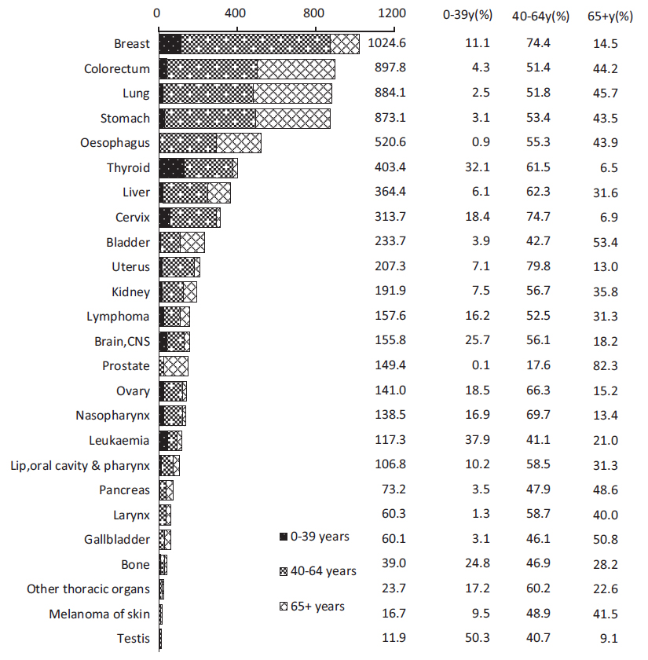
5-year cancer-specific prevalence counts (thousands) and proportions by age groups in China, 2011.

Slide 12
Cancer in the world
~ 12.4 million people will be diagnosed with cancer in 2008
~ 7.6 million people will die of cancer
Cancer is #1 killer after 2010, surpassing heart disease

Slide 13
Cancer is the #1 killer for ages younger than 85
Jemal et al (2007) American Cancer Society

Slide 14
Cancer incidence as a function of age
All cancer combined
Notes:
对数曲线

Slide 15
Cancer incidence as a function of age
胰腺
食管
Vogelstein & Kinzler (1993) Trends Genet 9:101
Notes:
很多常见肿瘤发病率随年龄增长而指数上调。注意这张图年龄到80岁为止

Slide 16
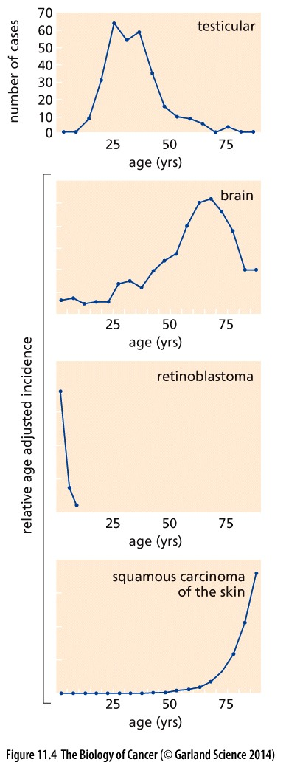
睾丸
Cancer incidence as a function of age
视网膜母细胞瘤
Some cancer incidence declined after certain ages.

Slide 17
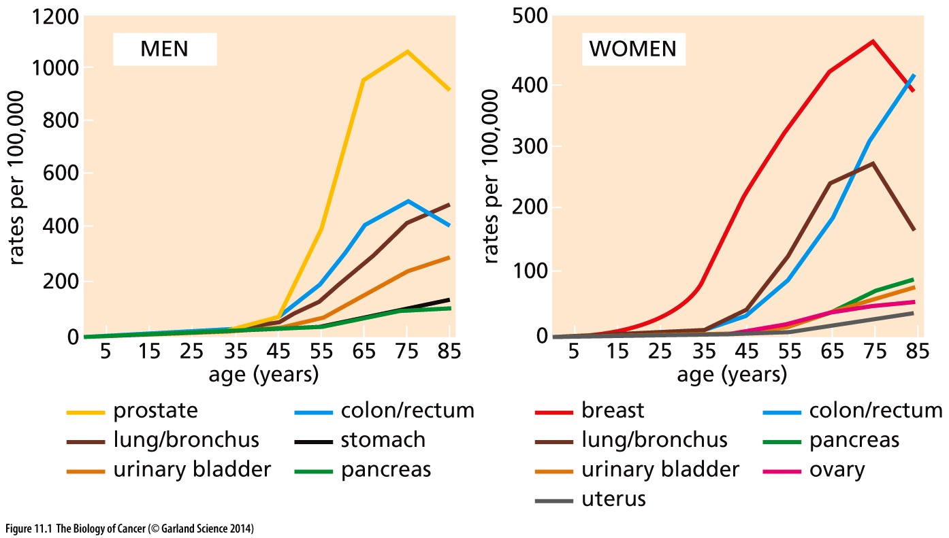
Cancer incidence at various ages
Some common cancer like prostate, breast, lung cancer incidence declined in very old people.
Notes:
如果把年龄这个坐标轴延长，一些常见肿瘤发病率也是下调

Slide 18
Older people generally have more chance to development cancer (Age 0-85)
But very old people (>85 years) develop cancer at reduced rate
Why?
Notes:
重点。 想想为什么？ 上完这门课估计大家应该对这个问题有自己的答案。这个问题分解为两个问题，第一为什么年纪越大肿瘤发病越高？第二为什么年纪足够大发病反而降低？

Slide 19
Common Causes of cancer
Infection
Nearly 20% of all cancers are caused by infection, by virus, bacterial of other microorganisms
Human papillomavirus (HPV) (人乳头瘤病毒) increases the risk for cancers of the cervix (子宫颈), penis, vagina, anus, and oropharynx (口咽).
Hepatitis B and hepatitis C viruses increase the risk for liver cancer.
Epstein-Barr virus increases the risk for Burkitt lymphoma.
Helicobacter pylori(幽门螺旋杆菌) increases the risk for gastric cancer (胃癌).
Notes:
肿瘤发生运气占了不小成分，除此之外…

Slide 20
Radiation
Ultraviolet radiation from sunlight. This is the main cause of non-melanoma skin cancers.
Ionizing radiation including: Medical radiation from tests to diagnose cancer such as x-rays, CT scans, fluoroscopy, and nuclear medicine scans; Radon gas in our homes.
Chemicals
Tobacco (烟草) and Lung Cancer
Asbestos (石棉) and Lung Cancer
Aflatoxin (黄曲霉素) and Liver cancer

Slide 21
Cancer Diagnostic Tests
Biopsy
A small tissue sample is surgically removed and examined under a microscope for the presence of cancer cells.
Endoscopy
A flexible plastic tube with a tiny camera on the end is inserted into body cavities and organs, allowing the physician to view the suspicious area.
Blood Tests
Some tumors release substances called tumor markers, which can be detected in the blood.
Diagnostic Imaging
CT (computerized tomography) scan,
General/body ultrasound,
MRI (magnetic resonance imaging),
PET (positron emission tomography) scan,

Slide 22
Common types of cancer treatment
1. Surgery (外科手术)
2. Radiation Therapy (放疗)
1895 x-rays discovered
1903 first use to treat cancer
3. Chemotherapy (化疗)
Because of the fast proliferation feature of cancer cell. Chemotherapeutic agents are cytotoxic by means of interfering with cell division (mitosis).
Initial use after World War II. Typical chemotherapy drugs: doxorubicin, methotrexate, cisplatin, 5-fluorouracil, etc.
Notes:
重点, 二战后芥子气（可杀死增殖白细胞）用于肿瘤治疗，均杀死快速增殖细胞，

Slide 23
4. Targeted Therapy (靶向治疗)
Initiated after 1990s. Targeted therapies work by influencing the processes that control growth, division, and spread of cancer cells, as well as the signals that cause cancer cells to die naturally. Including: Growth signal inhibitors, Angiogenesis inhibitors, Apoptosis-inducing drugs. Most successful drugs include tyrosine kinase inhibitor (替尼类药物), Imatinib (Gleevec).
5. Immunotherapy (免疫疗法)
Currently very hot field for cancer drug development. Successful drugs include: CTLA-4 antibody, PD-1 antibody, PD-L1 antibody and genetically engineered T cells (eg. CAR-T) .
6. Precision Medicine (精准医疗)
Cancer genomics, initiated 2010s.
Personal cancer genomics → specific cancer drivers → precision therapy
Just started…
Notes:
PD-L1 抗体。。。
CAR-T 价格和效果。。。

Slide 24
Brief introduction to cancer related Genetics and Molecular Biology
1, Gene, chromosome and evolution
2, Somatic genetic alterations in cancer
3, From gene to cancer phenotype
Notes:
分子生物学内容博大精深，这门课简单讲几点。下面的图片内容主要来自参考书，内容挺杂，总结有如下三个方面

Slide 25
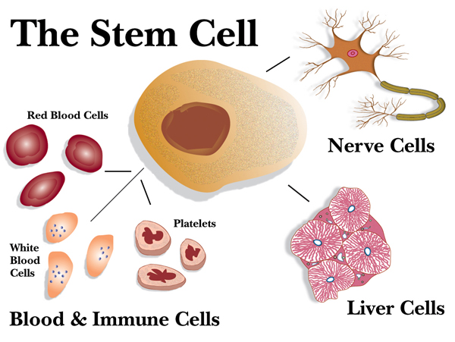
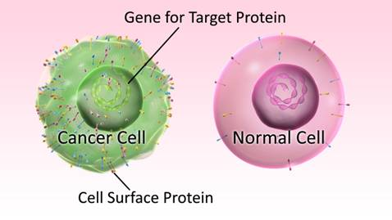
Somatic cell : Stem cell -- Epigenetic difference
Cancer cell : Normal cell -- Genetic difference
Notes:
重点

Slide 26
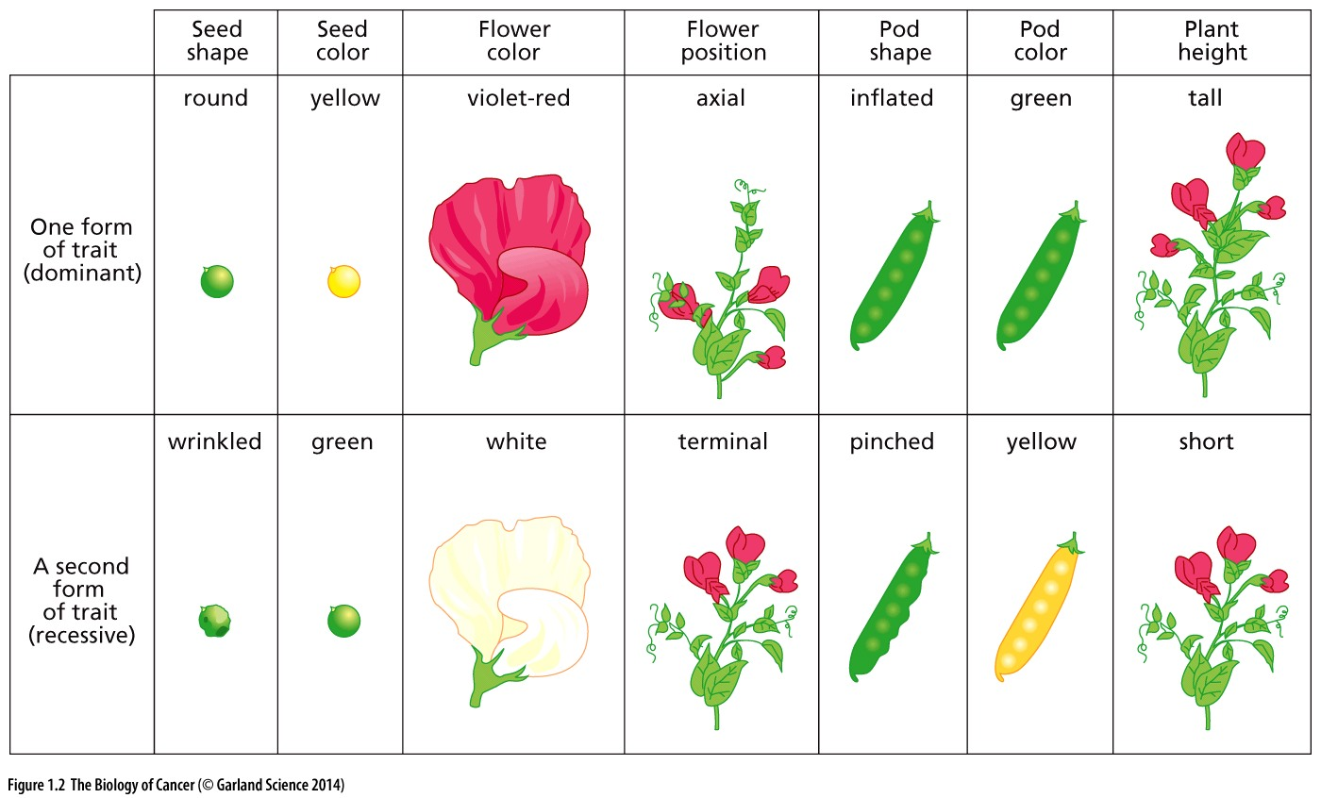
Mendel`s theory of inheritance
The gene and inheritance

Slide 27
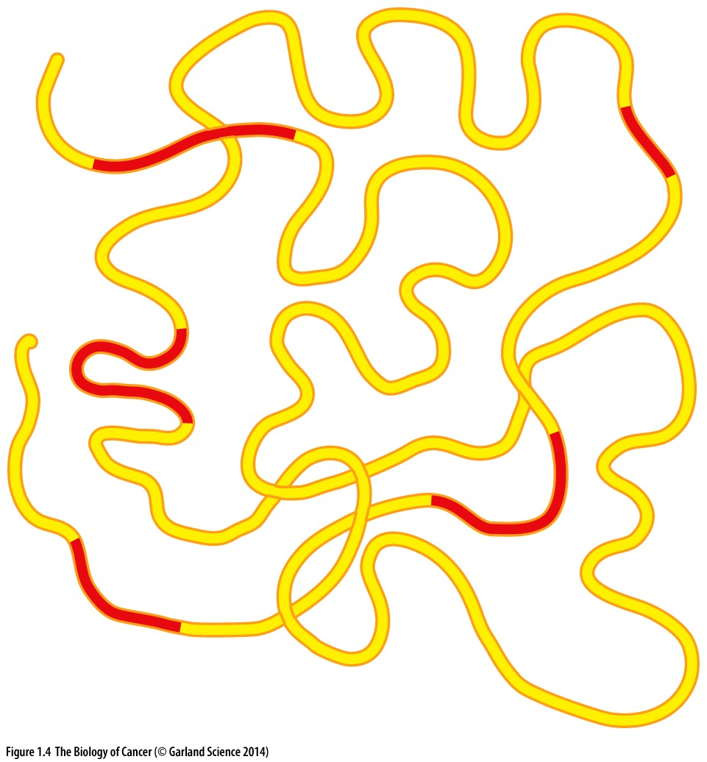
Figure 1.4 Biologically important sequences in the human genome
The human genome can be characterized as a collection of relatively small islands of biologically important sequences floating amid a sea of “junk” DNA (yellow).
The blanket (总括的) classification of all genomic sequences localized between a human cell’s ~21,000 protein-coding genes as useless junk is simplistic.

Slide 28
Human genome overview
Total sequence: 3,095,693,981bp, 3.1 billion（31亿） base pair per haploid (单倍体) genome
Protein coding genes: 20,000 – 21,000
Protein coding sequence: 1.1% of total genome
Conserved non-coding sequence: 4% of total genome (Most of them function is unknown)
Biological important sequence: ???%

Slide 29
Sequence classes in the human nuclear and mitochondrial genomes.

Slide 30
Size of protein-coding genes
The size of protein-coding genes within the human genome shows enormous variability
Dystrophin (DMD) is the largest protein-coding gene in the human reference genome, spanning a total of 2.2 MB,
Titin (TTN) has the longest coding sequence (114,414 bp),
The largest number of exons (363),
The longest single exon (17,106 bp). Over the whole genome,
The median size of an exon is 122 bp (mean = 145 bp), the median number of exons is 7 (mean = 8.8), and the median coding sequence encodes 367 amino acids (mean = 447 amino acids).

Slide 31
Size of protein-coding genes
Protein | Chrom | Gene | Length | Exons | Exon length | Intron length | Alt splicing
Breast cancer type 2 susceptibility protein | 13 | BRCA2 | 83,736 | 27 | 11,386 | 72,350 | yes
Cystic fibrosis transmembrane conductance regulator | 7 | CFTR | 202,881 | 27 | 4,440 | 198,441 | yes
Cytochrome b | MT | MTCYB | 1,140 | 1 | 1,140 | 0 | no
Dystrophin | X | DMD | 2,220,381 | 79 | 10,500 | 2,209,881 | yes
Glyceraldehyde-3-phosphate dehydrogenase | 12 | GAPDH | 4,444 | 9 | 1,425 | 3,019 | yes
Hemoglobin beta subunit | 11 | HBB | 1,605 | 3 | 626 | 979 | no
Histone H1A | 6 | HIST1H1A | 781 | 1 | 781 | 0 | no
Titin | 2 | TTN | 281,434 | 364 | 104,301 | 177,133 | yes
From Wikipedia “Human Genome”

Slide 32
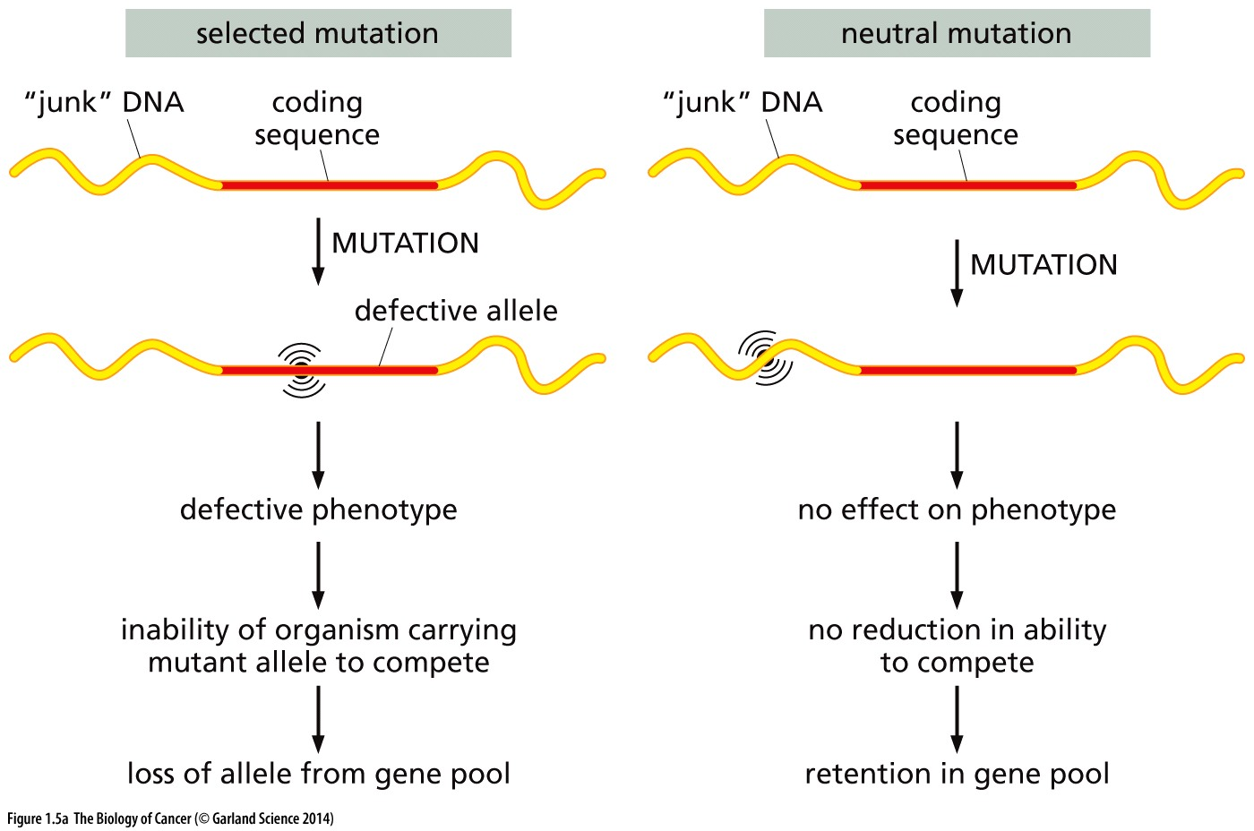
Figure 1.5 Neutral mutations and evolution
Mutation and selection for:
No effect
OR
Enhancing effect
Notes:
肿瘤也是evolution，优胜劣汰，最后长出来的都是strong肿瘤细胞

Slide 33
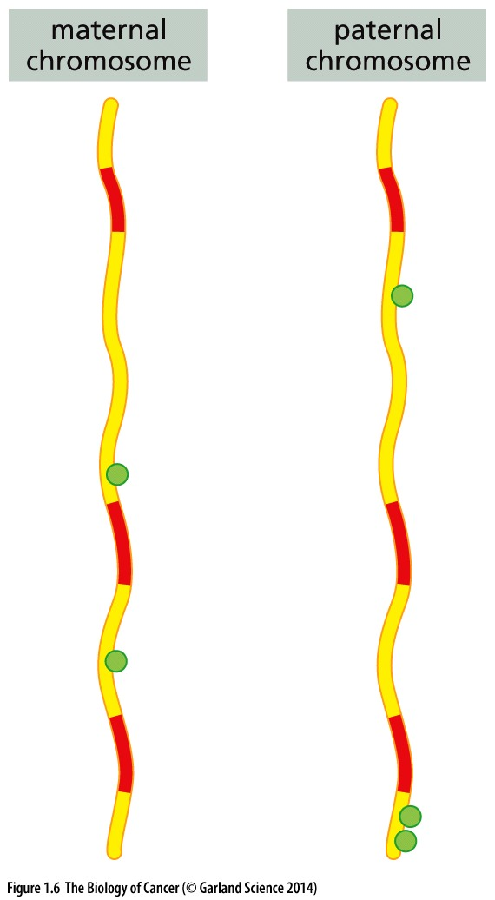
Figure 1.6 Polymorphic diversity in the human gene pool
Because the great majority of human genomic DNA does not encode biologically important information (yellow), it has evolved relatively rapidly and has accumulated many subtle differences in sequences—polymorphisms(多态性)— that are phenotypically silent.

Slide 34
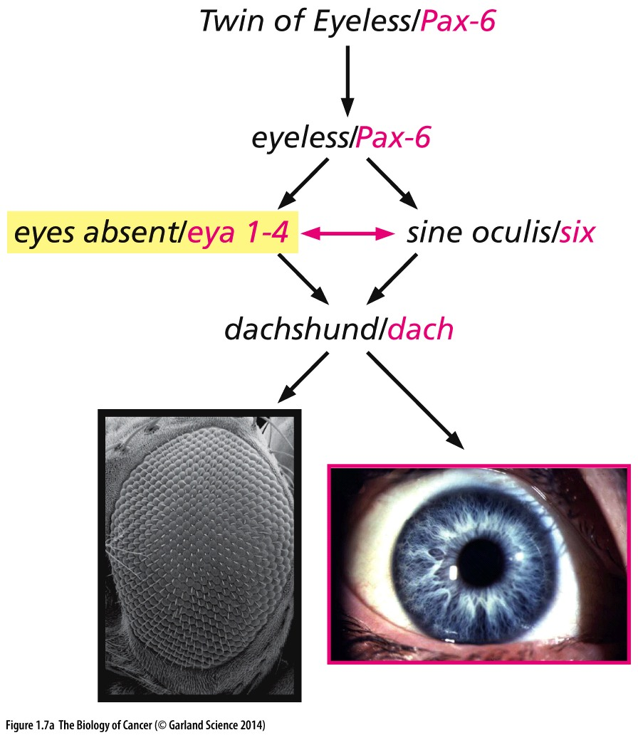
Figure 1.7 Extraordinary conservation of gene function
The last common ancestor(祖先) of flies and mammals lived more than 600 million years ago. Moreover, fly eyes and mammalian eyes show totally different architectures. Nevertheless, the genes that orchestrate their development (eyeless in the fly, Pax-6/small eye in the mouse) are interchangeable—the gene from one organism can replace the corresponding mutant gene from the other and restore wild-type function. Thus, the genes encoding components of the signal transduction cascades that operate downstream of these master regulators to trigger eye development (black for flies, pink for mice) are also highly conserved and interchangeable.

Slide 35
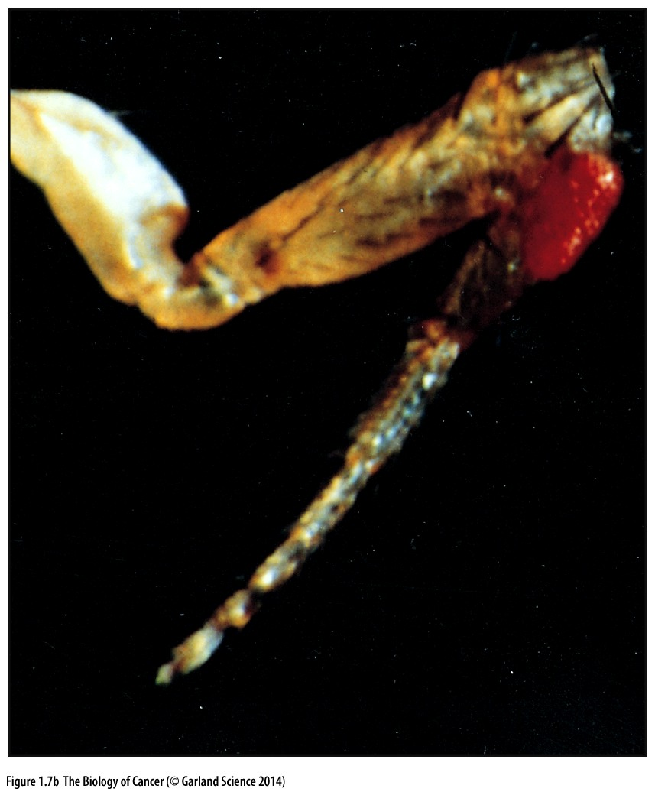
The expression of the mouse Pax-6/small eye gene, like the Drosophila eyeless gene, in an inappropriate (ectopic) location in a fly embryo results in the fly developing a fly eye on its leg, demonstrating the interchangeability of the two genes.

Slide 36
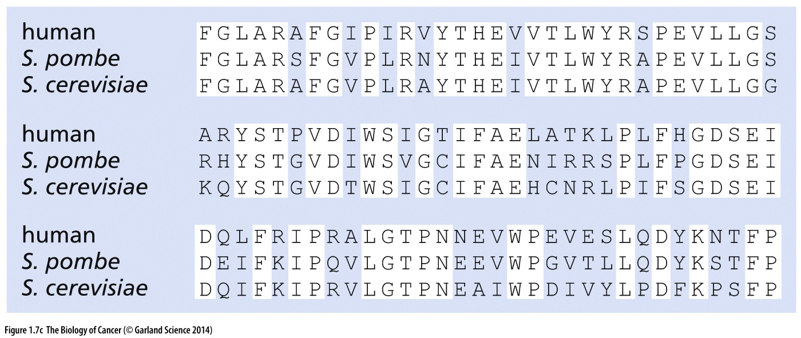
The conservation of genetic function over vast evolutionary distances is often manifested in the amino acid sequences of homologous proteins. Here, the amino acid sequence of a human protein is given together with the sequences of the corresponding proteins from two yeast(酵母) species, S. pombe and S. cerevisiae.

Slide 37
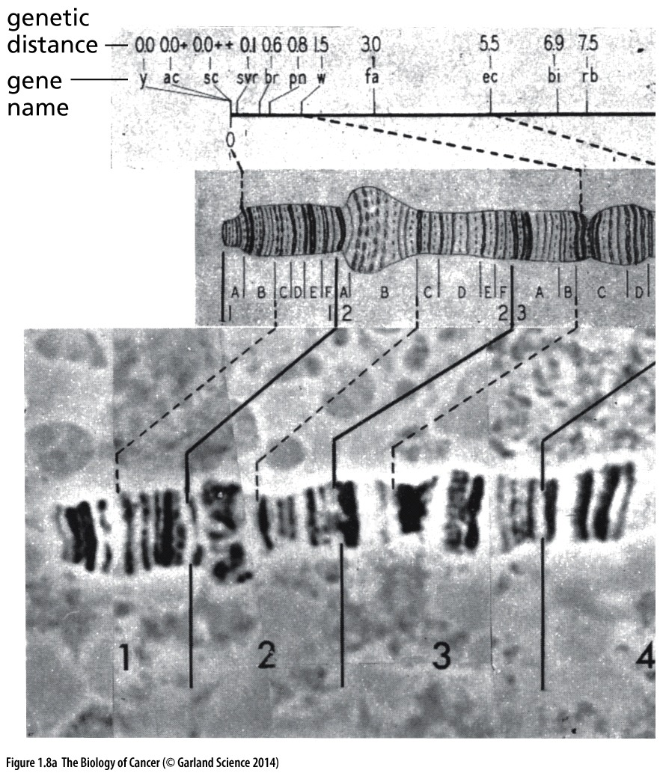
Figure 1.8 Localization of genes along chromosomes
The physical structure of Drosophila chromosomes was mapped by using the fly’s salivary gland chromosomes(唾液腺染色体), which exhibit banding patterns resulting from alternating light (sparse) and dark (condensed) chromosomal regions (bottom). Independently, genetic crosses yielded linear maps (top) of various genetic loci arrayed along the chromosomes. These loci were then aligned with physical banding maps, like the one shown here for the beginning of the left arm of Drosophila chromosome 1.
Notes:
基因在染色体上分布，唾液腺染色体为例，是一个常识，预计高中时也提到过

Slide 38
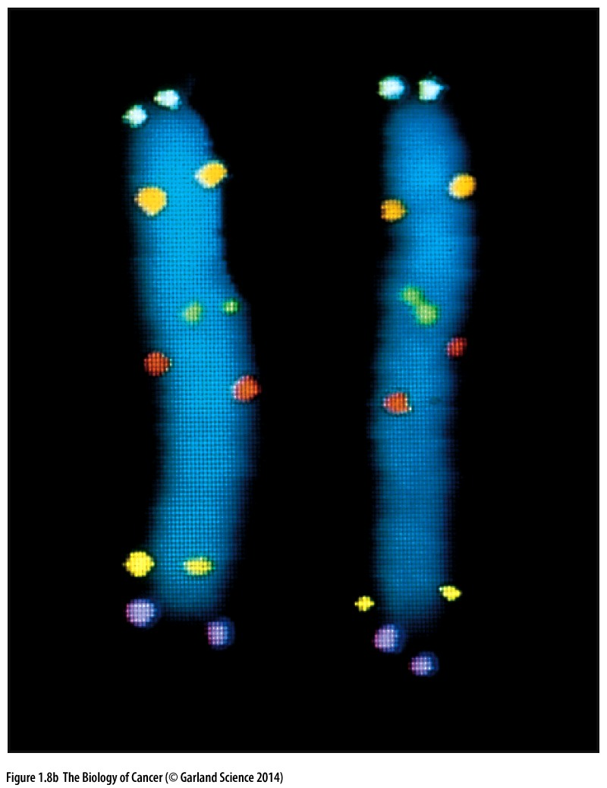
Figure 1.8 Localization of genes along chromosomes
The availability of DNA probes that hybridize specifically to various genes now makes it possible to localize genes along a chromosome by tagging each probe with a specific fluorescent dye or combination of dyes. Shown are six genes that were localized to various sites along human Chromosome 5 by using fluorescence in situ hybridization (FISH) during metaphase. (There are two dots for each gene because chromosomes are present in duplicate form during metaphase of mitosis.)
Notes:
荧光原位杂交技术

Slide 39
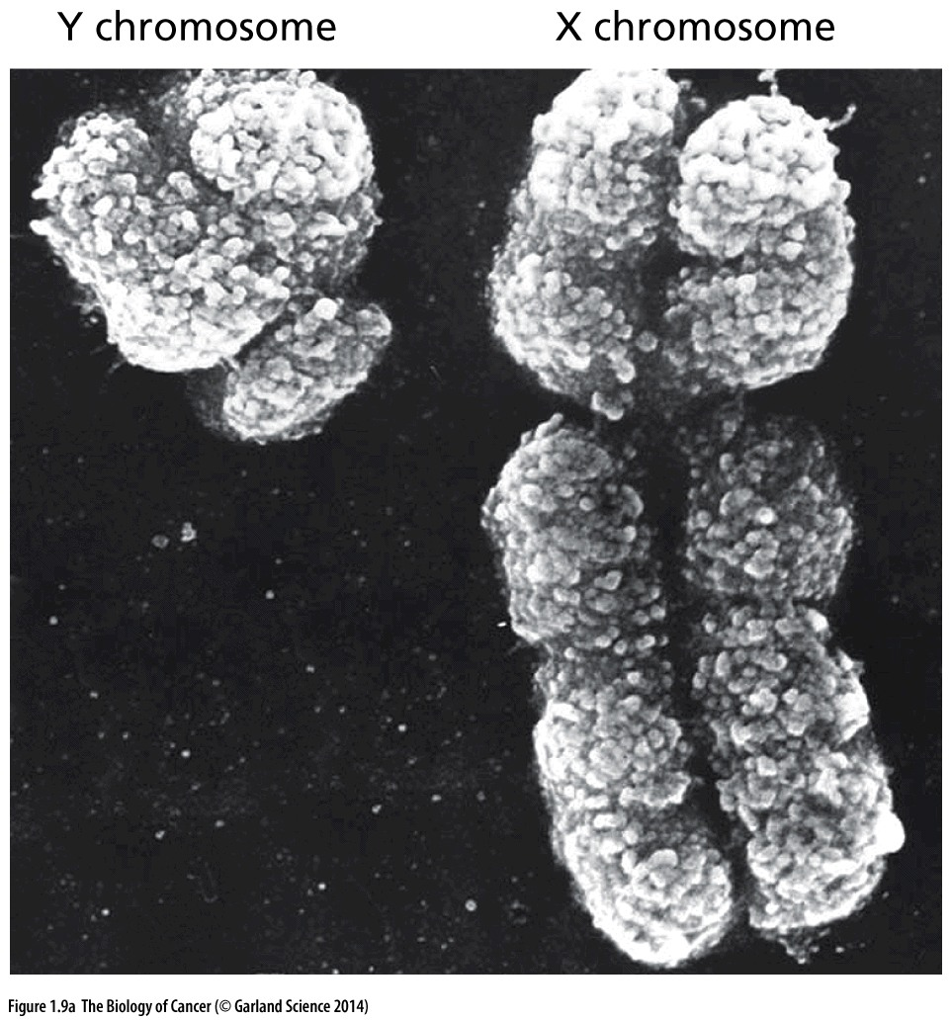
Figure 1.9 Physical maps of human sex chromosomes
Scanning electron micrograph of human X and Y chromosomes. Like the 22 autosomes (nonsex chromosomes), they have been sequenced.

Slide 40
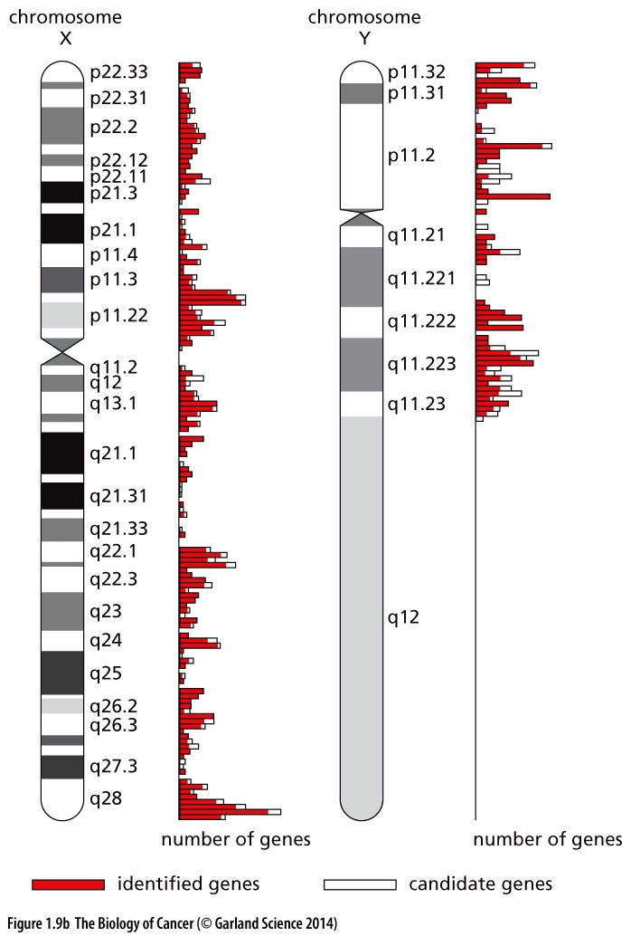
Figure 1.9 Physical maps of human sex chromosomes
the cytologic maps of these chromosomes (determined by microscopically examining stained chromosomes at the metaphase(中期) of mitosis（有丝分裂）) matched with their DNA sequence. Note that the short arm of a human chromosome is the “p” arm, while the long arm is the “q” arm. Identified genes are filled bars (red), while sequences that appear to encode still-to-be identified genes are in open bars; in most chromosomal regions the latter represent a small minority. The human Y chromosome is ~57 megabases (Mb) long, compared with the X chromosome’s ~155 Mb.

Slide 41
1.4 Chromosomes are altered in most types of cancer cells
Euploid（整倍体）: normal configuration of chromosomes
Aneuploidy（非整倍性）: deviation from the euploid karyotype
Notes:
章节标题，这个结论希望大家能记住

Slide 42
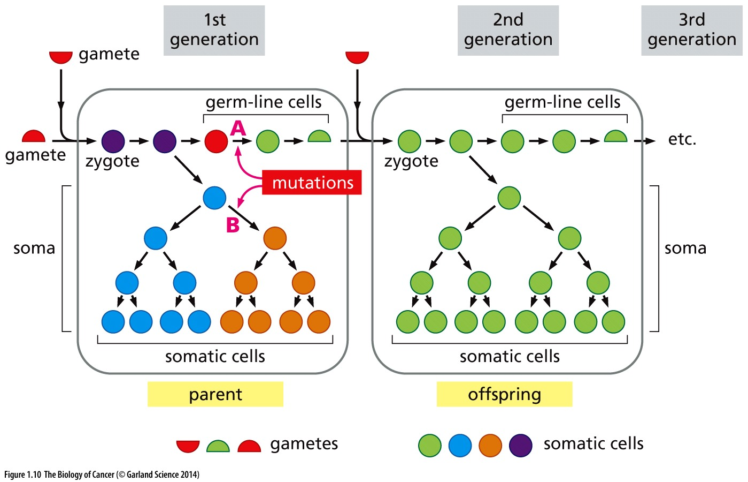
Figure 1.10 Germ-line versus somatic mutations
Mutation A, which occurs in the genome of a germ-line cell in the gonads（性腺）, can be passed from parent to offspring(后代) via gametes(配子)—sperm or egg. However, mutation B, which strikes the genome of a somatic cell in the parent, can be passed only to the lineal descendants(后代) of that mutant cell within the body of the parent and cannot be transmitted to offspring.
Notes:
重点

Slide 43
Somatic mutation (体细胞变异) in genomic DNA is the major cause of cancer

Slide 44
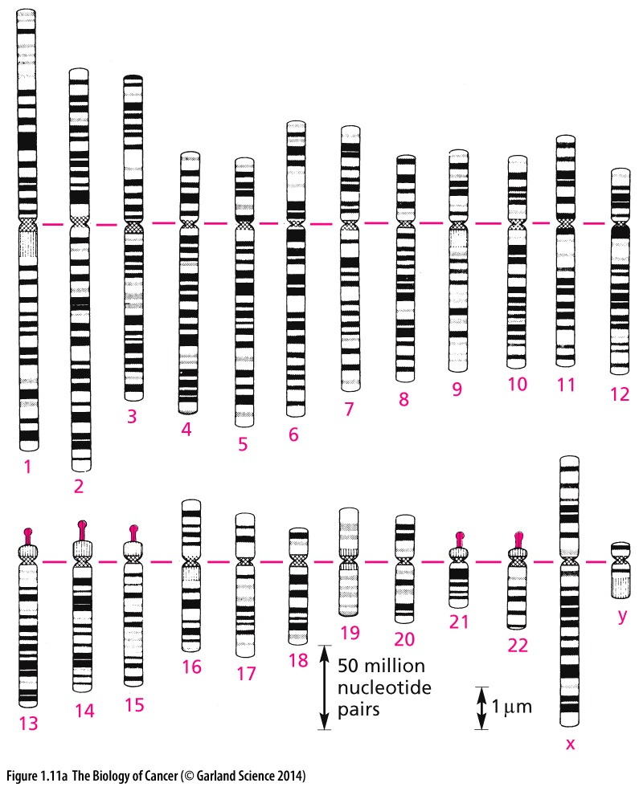
Figure 1.11 Normal and abnormal chromosomal complements(染色体组型)
Staining of metaphase chromosomes （中期染色体） reveals a characteristic light and dark banding pattern for each. The full array of human chromosomes is depicted; their centromeres(着丝粒) are aligned (pink line).
Notes:
正常人细胞有22对常染色体，1对性染色体

Slide 45
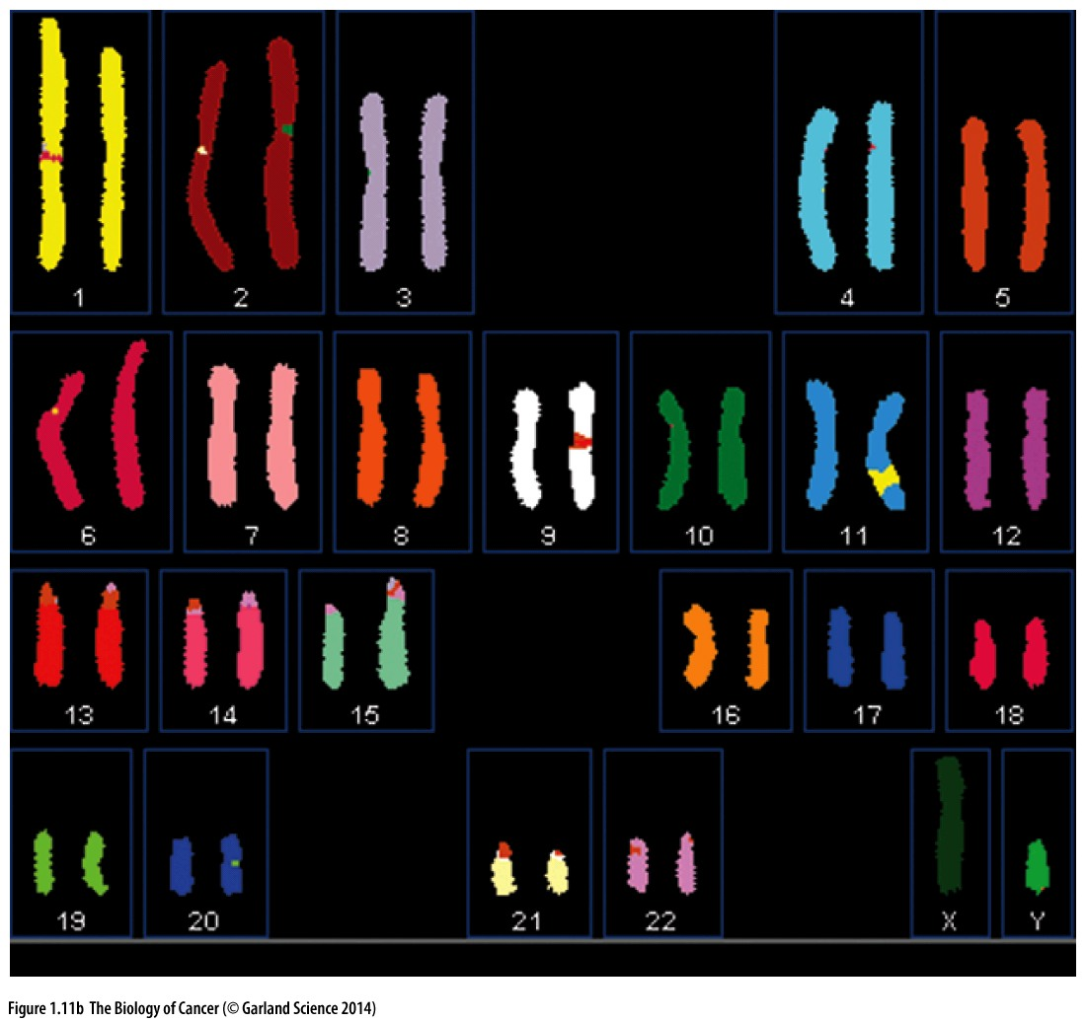
Figure 1.11 Normal and abnormal chromosomal complements(染色体组型)
The techniques of spectral karyotype (SKY)（光谱核型） analysis and multicolor fluorescence in situ hybridization (mFISH) allow an experimenter to “paint” each metaphase chromosome with a distinct color (by hybridizing chromosome-specific DNA probes labeled with various fluorescing dyes to the chromosomes). The diploid(二倍体) karyotype of a normal human male cell is presented. (The small regions in certain chromosomes that differ from the bulk of these chromosomes represent hybridization artifacts.)
Notes:
多色荧光原位杂交技术，

Slide 46
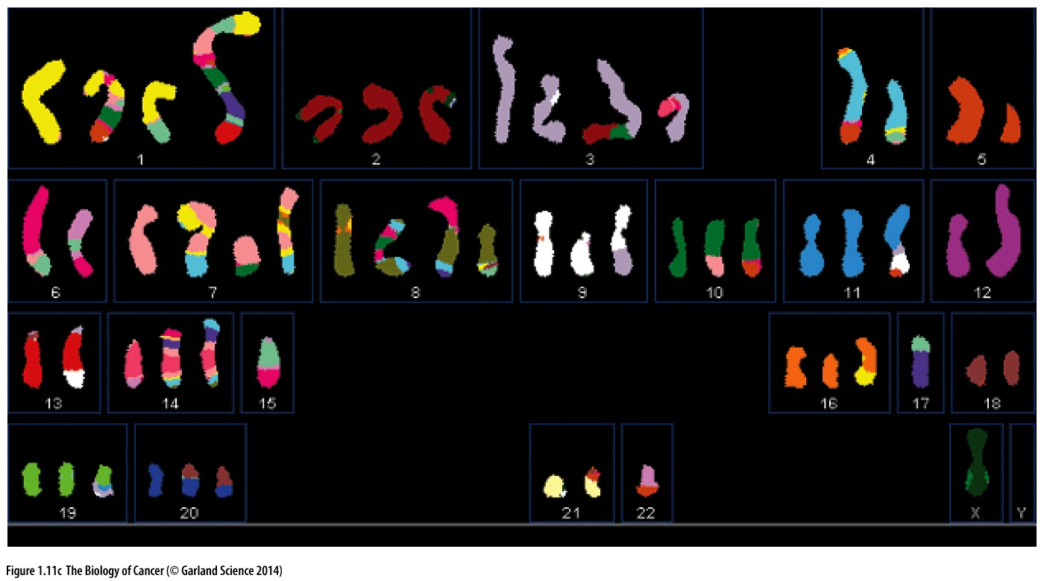
Figure 1.11 Normal and abnormal chromosomal complements(染色体组型)
The aneuploid （非整倍性） karyotype of a human pancreatic cancer cell, in which some chromosomes are present in inappropriate numbers and in which numerous translocations (exchanges of segments between chromosomes) are apparent.

Slide 47
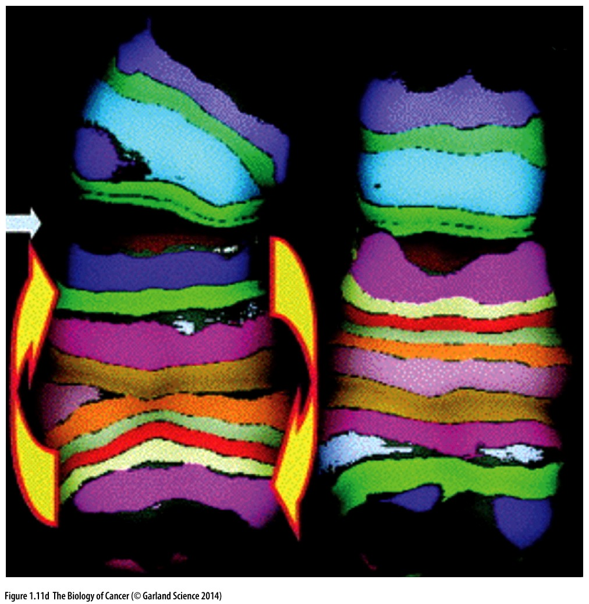
Figure 1.11 Normal and abnormal chromosomal complements(染色体组型)
Here, mFISH was used to label intrachromosomal subregions with specific fluorescent dyes, revealing that a large portion of an arm of normal human Chromosome 5 (right) has been inverted (left) in cells of a worker who had been exposed to plutonium(钚) in the nuclear weapons industry of the former Soviet Union.

Slide 48
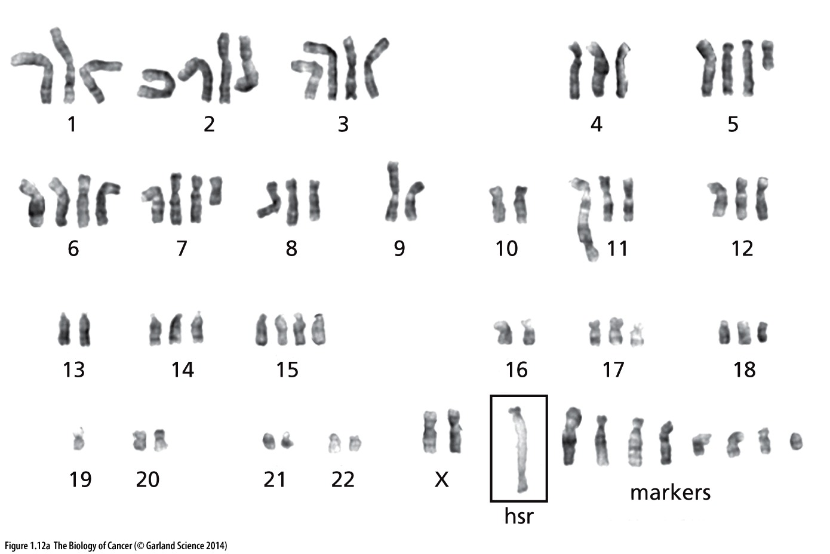
Figure 1.12 Increases and decreases in copy number of chromosomal segments
The amplification in the copy number of the myc oncogene (see Section 8.9) in a human neuroendocrinal tumor has caused an entire stretch of chromosome to stain white (rectangle), creating a homogeneously staining region (HSR).

Slide 49
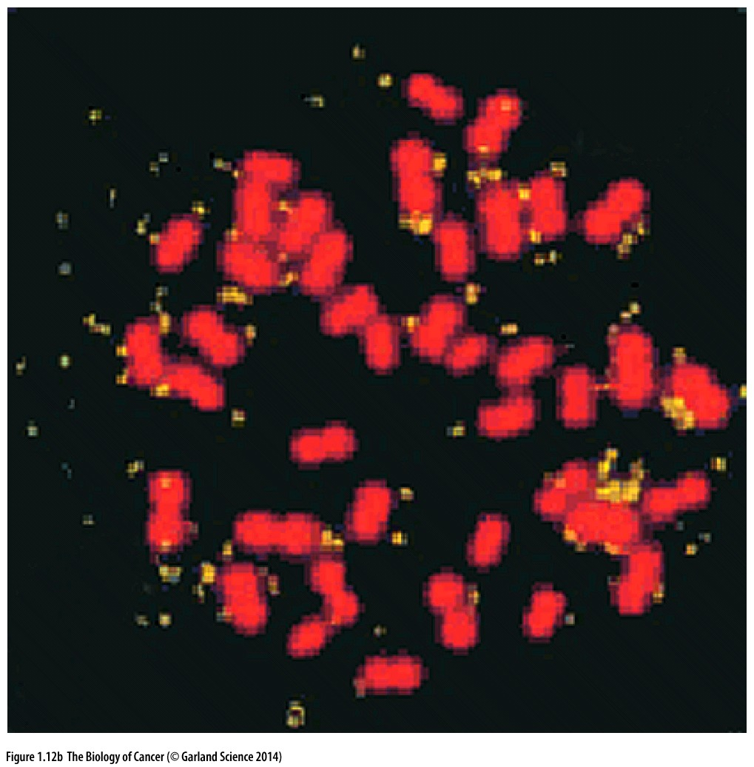
Figure 1.12 Increases and decreases in copy number of chromosomal segments
Double-minute chromosomes (DMs)(双微染色体) derive from chromosomal segments that have broken loose from their original sites and have been replicated repeatedly as extrachromosomal genetic elements; like normal chromatids, these structures are doubled during metaphase of mitosis. FISH reveals the presence of amplified copies of the HER2/neu oncogene borne on DMs (yellow dots) in a mouse breast cancer cell.

Slide 50
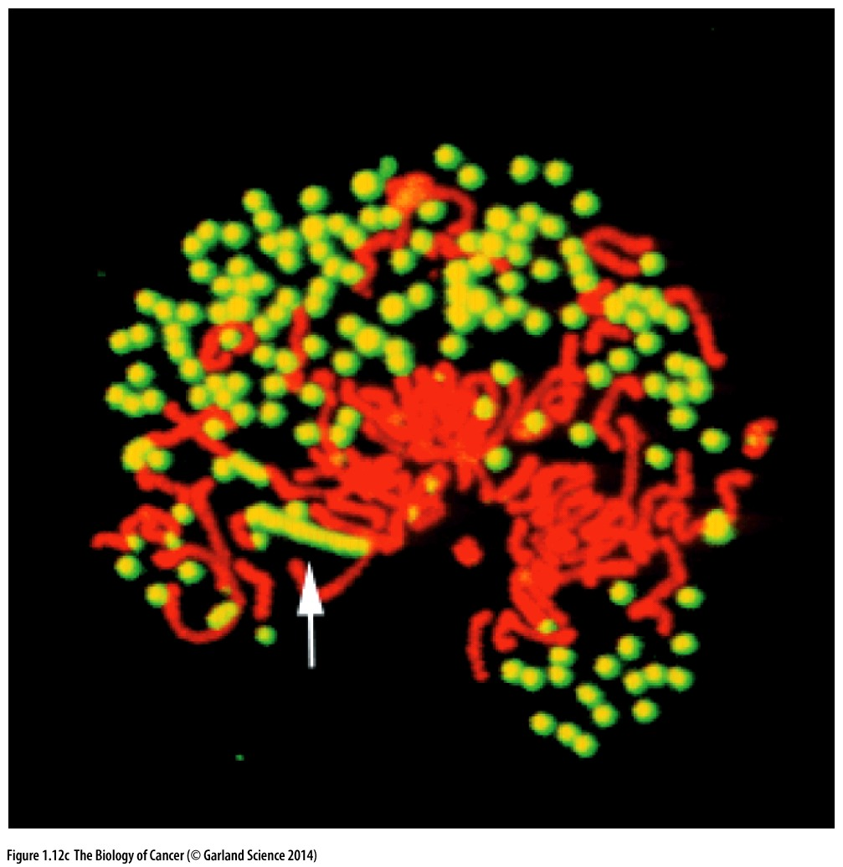
Figure 1.12 Increases and decreases in copy number of chromosomal segments
Occasionally, an amplified gene may be found both in an HSR (nested within a chromosome) and in DMs. Here, analysis of COLO320 cells reveals multiple copies of the myc oncogene (yellow), amid the chromosomes (red). One HSR is indicated by the arrow, while many dozens of DMs are apparent.

Slide 51
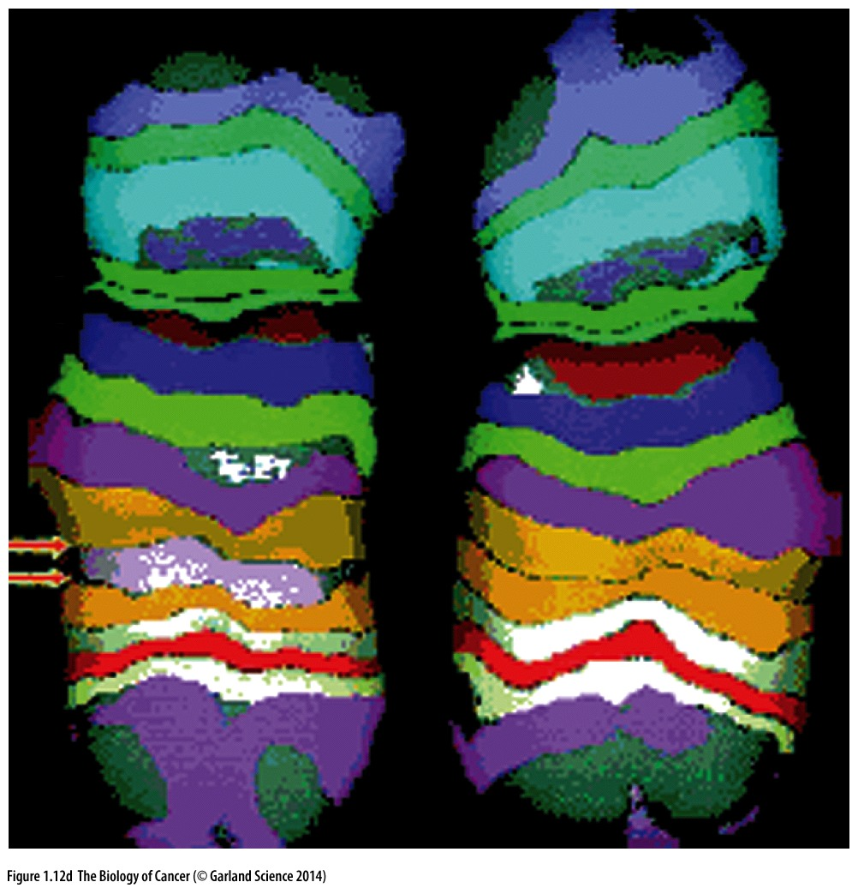
Figure 1.12 Increases and decreases in copy number of chromosomal segments
The use of multicolor FISH (mFISH) revealed that a segment within normal human Chromosome 5 (paired arrows, left) has been deleted (an interstitial deletion, right) following extensive exposure to radiation from plutonium.

Slide 52
1.6 Genotype embodied in DNA sequences creates phenotype through proteins

Slide 53
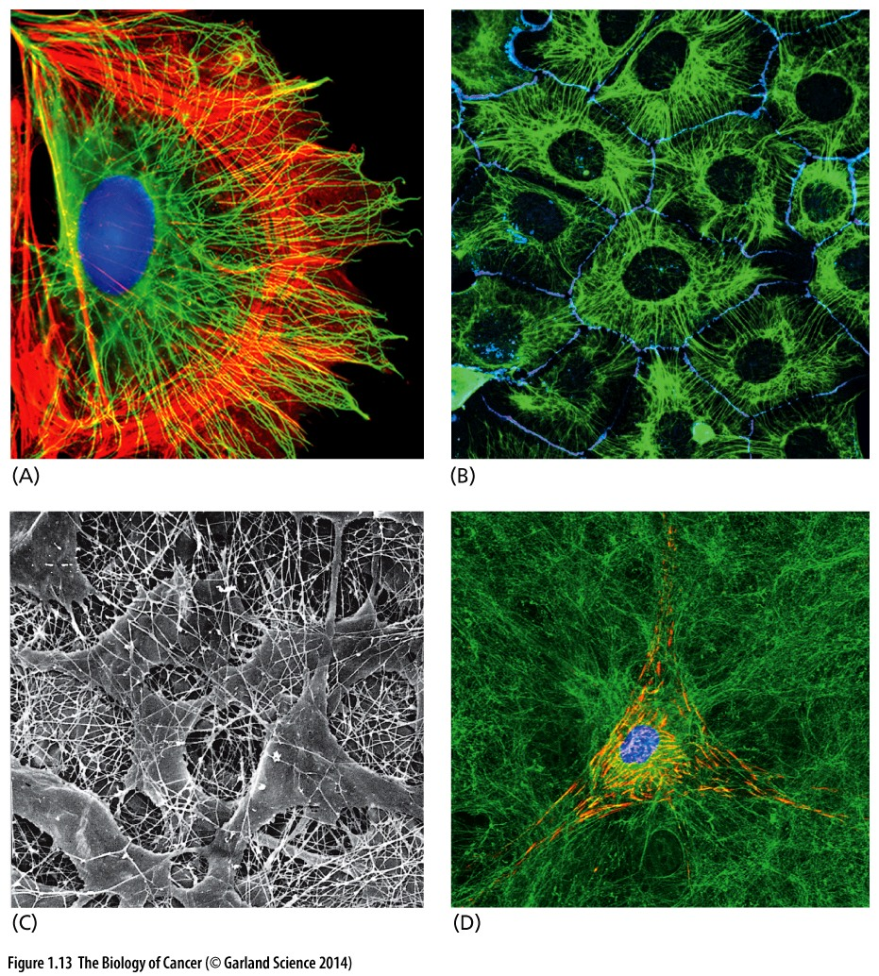
Figure 1.13 Intracellular and extracellular scaffolding（骨架）
The cytoskeleton is assembled from complex networks of intermediate filaments(中间丝), actin microfilaments(微丝), and microtubules(微管). Together, they generate the shape of a cell and enable its motion.

Slide 54
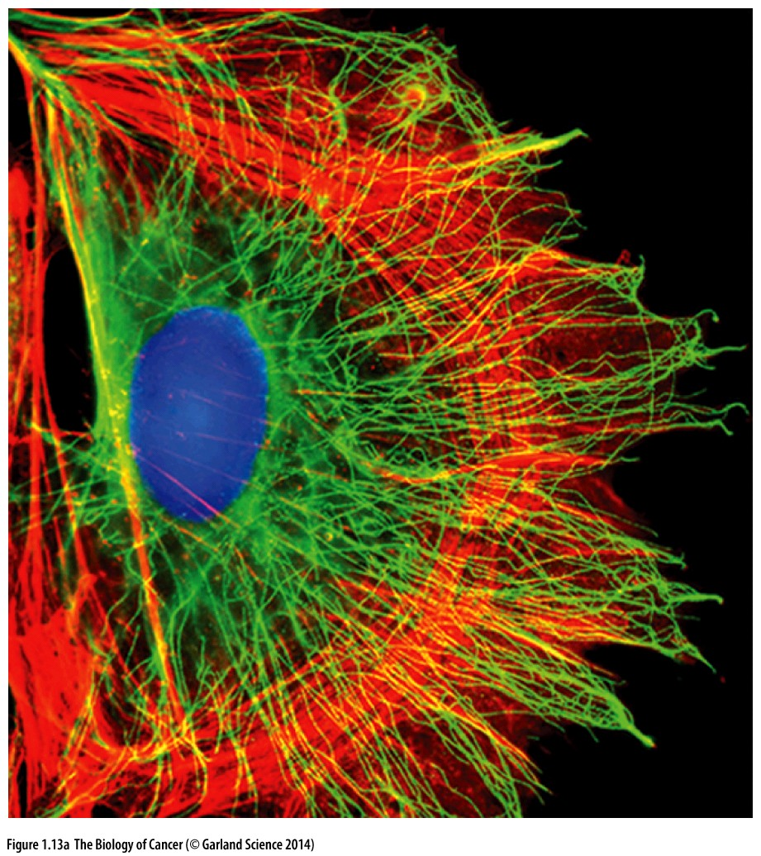
Figure 1.13 Intracellular and extracellular scaffolding
Immunofluorescence(免疫荧光) pictures
Protocol：
Cell fix → permeablize →1st antibody → fluorescent 2nd Ab → fluorescent microscope
DAPI: Blue, nucleus DNA staining dye;
Microfilaments composed of actin (orange) form bundles that lie parallel to the cell surface while microtubules composed of tubulin (green) radiate outward from the nucleus (blue).

Slide 55
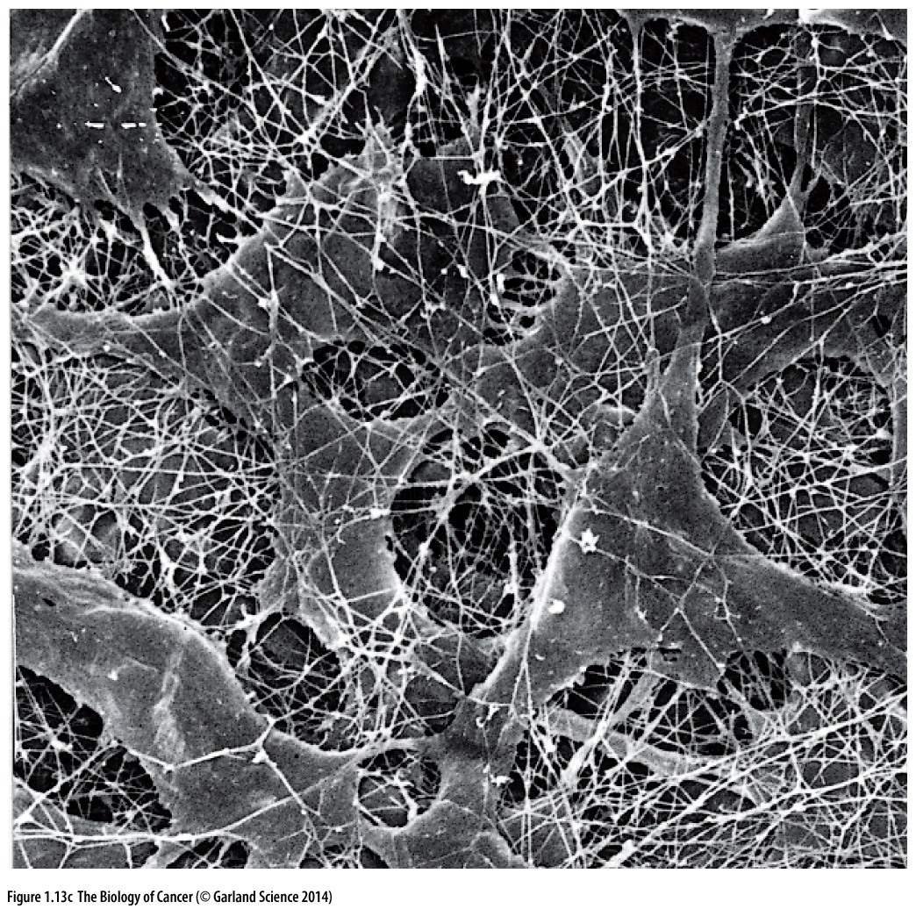
Figure 1.13 Intracellular and extracellular scaffolding
Cells secrete a diverse array of proteins that are assembled into the extracellular matrix (ECM). A scanning electron micrograph reveals the complex meshwork of collagen fibers, glycoproteins, hyaluronan(透明质酸), and proteoglycans(蛋白多糖), in which fibroblasts (connective tissue cells) are embedded.
Notes:
细胞生活外环境

Slide 56
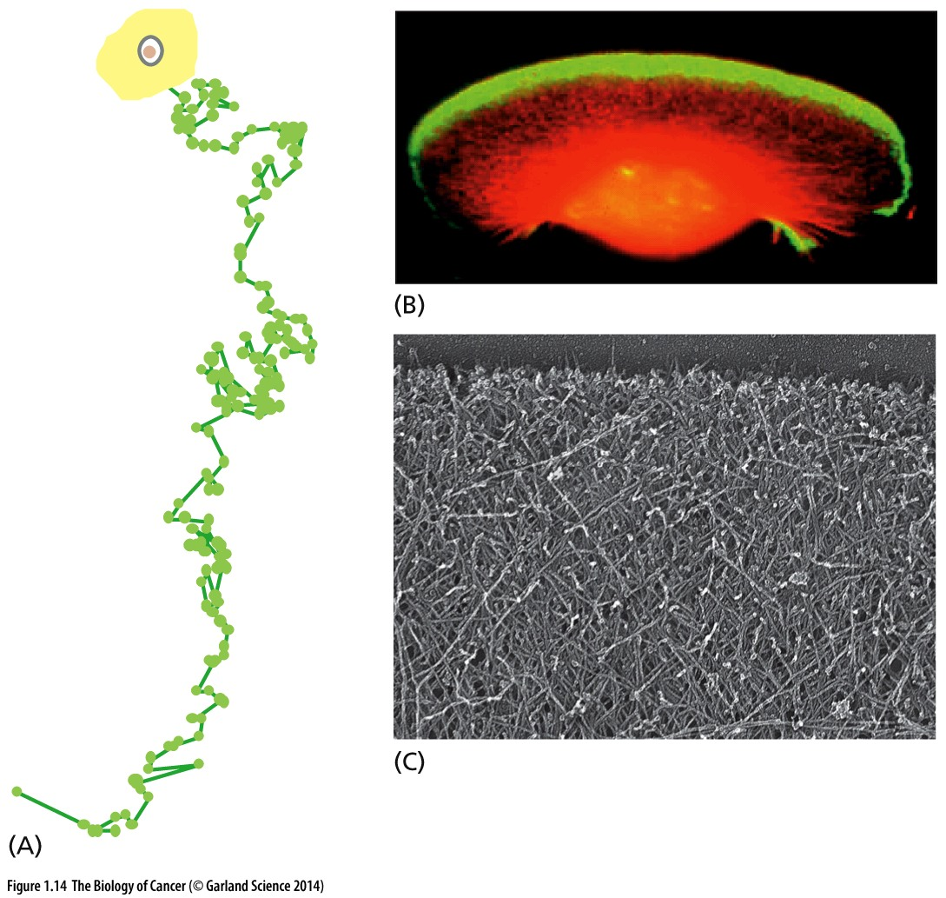
Figure 1.14 Cell motility
(A) This image traces the movement of a human vascular endothelial cell (the cell type that forms the lining of blood vessels) toward two attractants located at the bottom. Each point represents a position plotted at 10-minute intervals. This motility is made possible by complex networks of proteins that form the cells’ cytoskeletons. (B) The advancing cell is a fish keratocyte; its leading edge (green) is pushed forward by an actin filament network, such as the one shown in C. (C) Seen here is the network of actin filaments that is assembled at the leading edge of a motile cell.

Slide 57
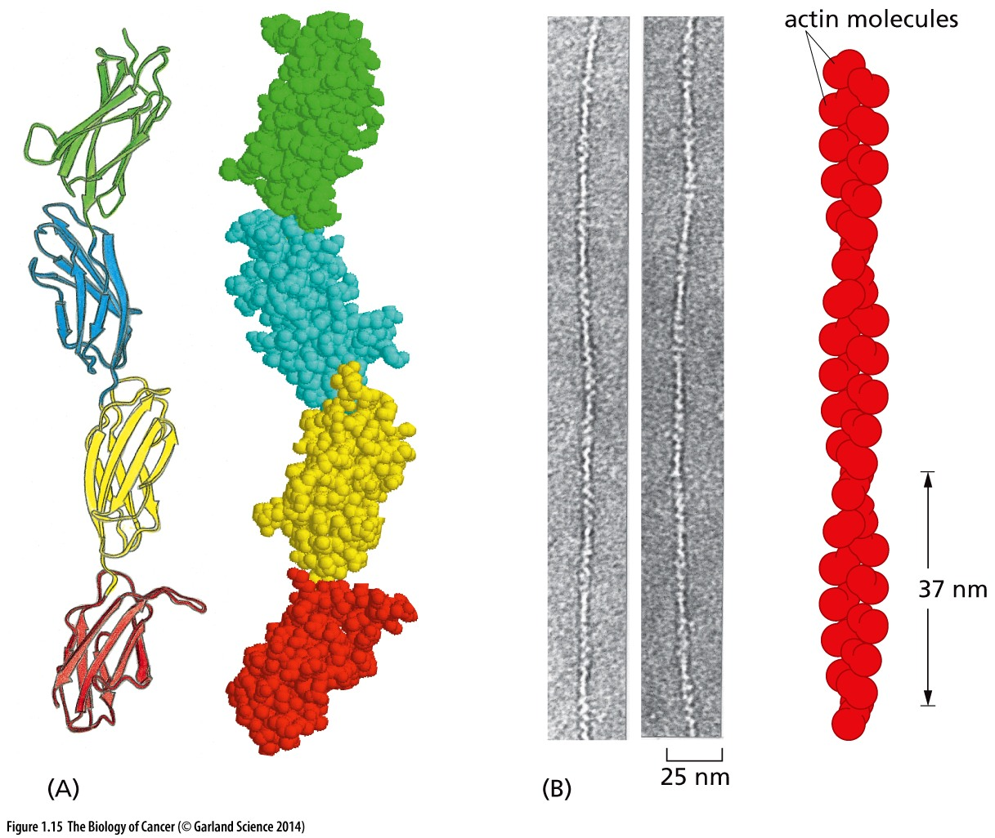
Figure 1.15 Structures of proteins and multiprotein assemblies
(A) The three-dimensional structure of part of fibronectin, an important extracellular matrix protein, is depicted as a ribbon diagram (left), which illustrates the path taken by its amino acid chain; alternatively, the space-filling model (right) shows the positions of the individual atoms. (B) The actin fibers (left), which constitute an important component of the cytoskeleton, are composed of assemblies of individual protein molecules, each of which is illustrated here as a distinct two-lobed(两瓣) body (right).
Notes:
细胞内很多高级结构都是由蛋白组成，单个蛋白直径在10nm之内，

Slide 58
Gene expression regulation in cancer
Processing of pre-mRNA
Gene expression patterns also control phenotype
Histone modification and transcription factors control gene expression
Heritable gene expression is controlled through additional mechanisms
Unconventional RNA molecules also affect the expression of genes

Slide 59
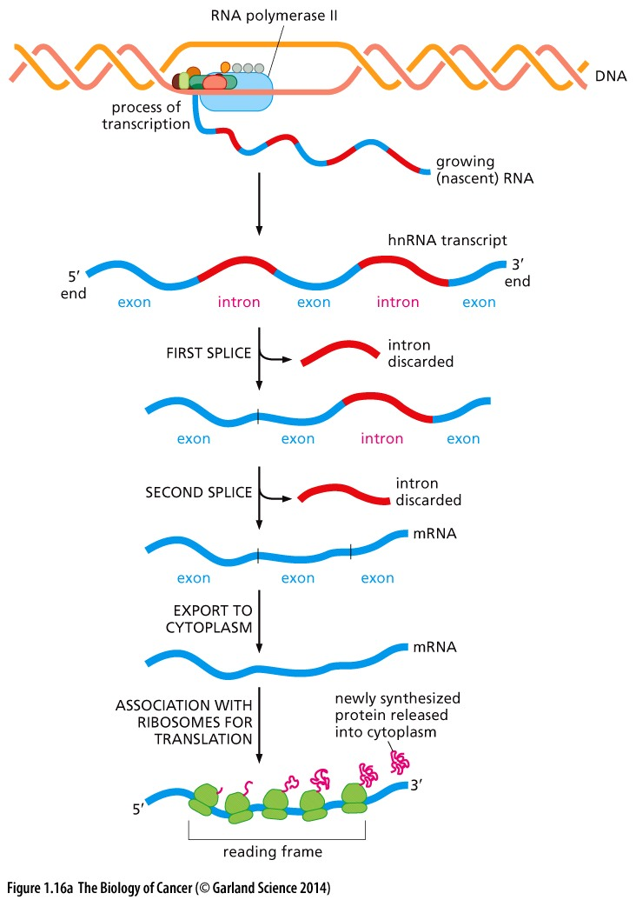
Figure 1.16 Processing of pre-mRNA

Slide 60
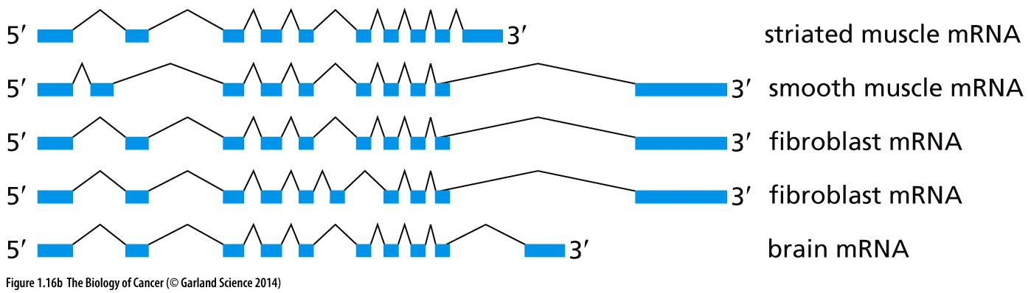
Alternative splicing

Slide 61
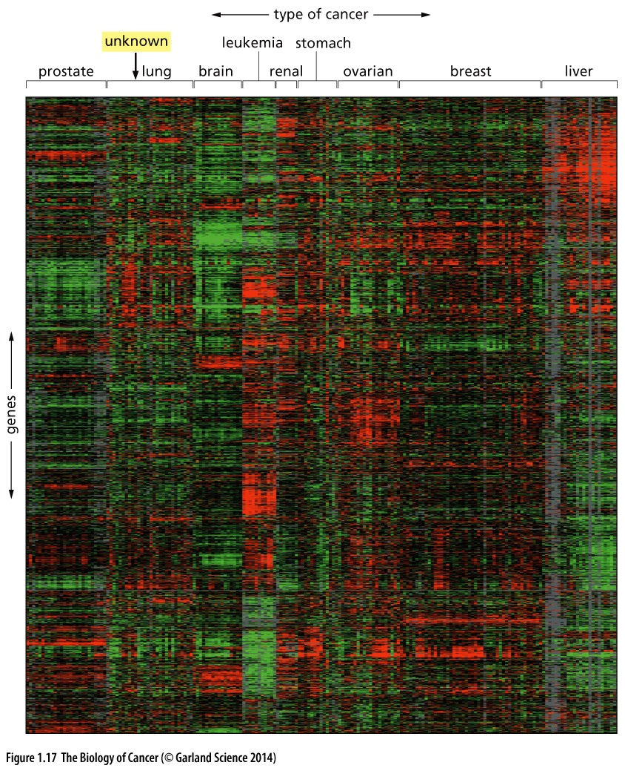
Figure 1.17 Global surveys of gene expression by microarrays
In this image, higher-than-average levels of expression are indicated as red pixels, while lower-than-average levels are indicated by green pixels. Average-level expression is indicated by black pixels. The mRNAs from 142 different human tumors (arrayed left to right) were analyzed. In each case, the expression levels of 1800 human genes were measured (top to bottom). Each class of tumors has its characteristic spectrum of expressed genes. In this case, a tumor of unknown type (yellow label) was judged to be a lung cancer because its pattern of gene expression was similar to those of a series of already-identified lung cancers.

Slide 62
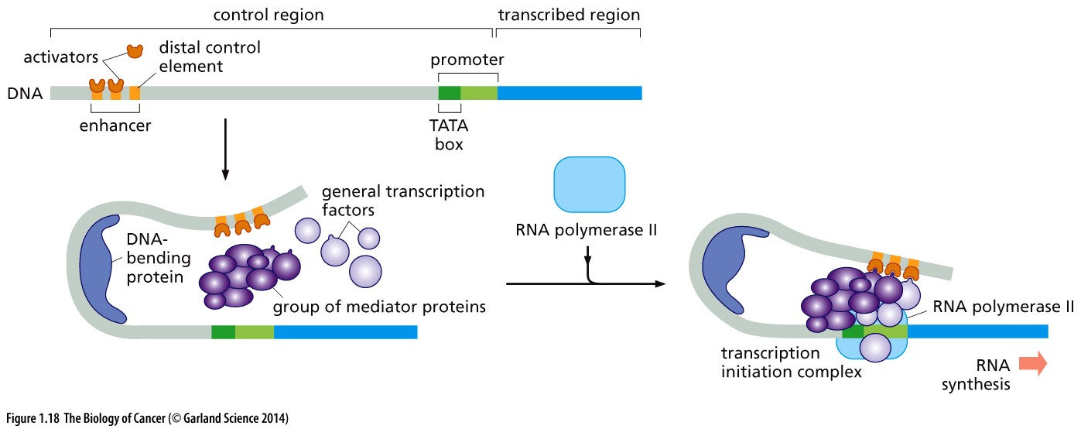
Figure 1.18 Regulation of gene expression
The control region of a gene includes specific segments of DNA to which gene regulatory proteins known as transcription factors (TFs) bind, often as multiprotein complexes.

Slide 63
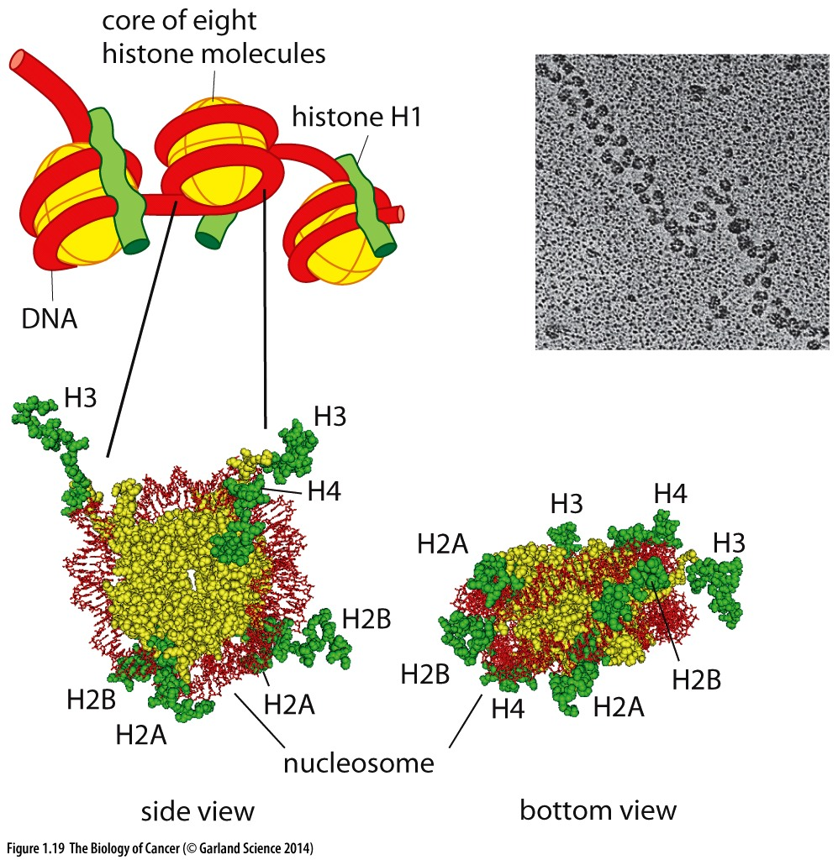
Figure 1.19 Organization of chromatin structure
Examination of chromatin under the electron microscope (above right) reveals that DNA is associated with small globes of proteins termed nucleosomes(核小体), giving the appearance of beads on a string(串珠). The DNA double-helix (above left, red) is wrapped ~1.7 times around each nucleosome.

Slide 64

Figure 1.20 Post-translational modification of histone tails
Each of these N-terminal histone tails can be modified by the covalent attachment of a variety of chemical groups, most commonly methyl, acetyl, phosphate, and ubiquitin groups.

Slide 65

One example of histone modification is provided by three of the lysine (K) residues in the amino-terminal domain of histone H3. Each of these can be trimethylated (indicated by “me3”) through the actions of histone methyltransferase writers (HMTs). Trimethylation at the K4 residue is carried out by the MLL1 HMT; the resulting methyl mark is recognized by a NURF (nucleosome remodeling factor) “reader” complex, which contributes to gene activation (green). Conversely, trimethylation of the K9 and K27 residues by the SUV39H1 and EZH2 HMT writers, respectively, results in gene repression (red). The methylation marks made by the latter two HMTs are recognized by the HP1 and Pc readers, respectively. Once bound, the HP1 reader can trigger the formation of heterochromatin and thereby block transcription.
Notes:
很形象的一个图

Slide 66

The locations of various modified histones can be mapped across a gene by using an antibody that specifically immunoprecipitates a modified histone species followed by DNA sequencing of the precipitate(Chip-Seq).

Slide 67

Figure 1.21 Maintenance of DNA methylation following replication
When a DNA double helix that is methylated at complementary CpG sites undergoes replication, the newly synthesized daughter helices will initially lack methyl groups attached to CpGs in the recently synthesized daughter strands (purple, red) and will therefore be hemi-methylated. Shortly after their synthesis, however, a maintenance DNA methyltransferase will detect the hemi-methylated DNA and attach methyl groups (green) to these CpGs, thereby regenerating the same configuration of methyl groups that existed in the parental helix prior to replication.

Slide 68

Figure 1.22 MicroRNAs and gene regulation
A primary microRNA (pri-miRNA) is transcribed from a gene, and an enzyme complex involving the Drosha protein excises a small segment of the pri-miRNA that has formed a double-stranded RNA hairpin because of the self-complementarity of nucleotide sequences. The resulting pre-miRNA is exported to the cytoplasm, where it is further processed by the Dicer enzyme to generate a mature miRNA of 21 to 25 nucleotides. This miRNA binds to a nucleoprotein complex termed RISC (RNA-induced silencing complex) and associates with mRNAs in the cytoplasm with which it has precise or partial sequence complementarity, resulting in either degradation of the mRNA or inhibition of its translation. Analyses of miRNA expression patterns, much like expression array analyses of mRNAs (see Figure 1.17), have proved useful in classifying various types of cancer.

Slide 69

Figure 1.24 Evolutionary development of gene families
The evolution of organismic complexity has been enabled, in part, by the development of increasingly specialized proteins. New proteins are “invented” largely through a process of gene duplication followed by diverging evolution of the two resulting genes. During vertebrate evolution, an ancestral globin gene, shown here, which encoded the protein component of hemoglobin, was duplicated repeatedly, leading to the large number of distinct globin genes in the modern mammalian genome that are present on two human chromosomes. Because these globins have distinct amino acid sequences, each can serve a specific physiologic function.

Slide 70
思考题
1，简述体细胞变异（somatic mutation）和生殖系变异（germ-line mutation）的异同点
2，简述肿瘤相关基因拷贝数扩增的多种发生方式

